Slide 1







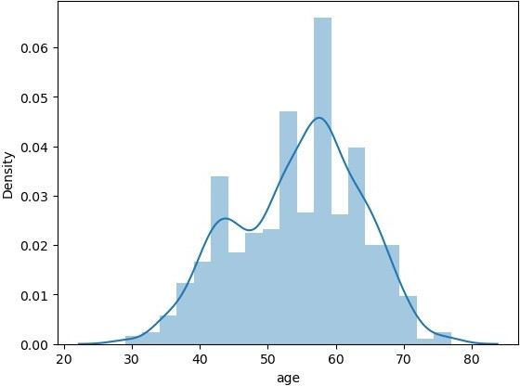

import numpy as np import pandas as pd import seaborn as sns
import matplotlib.pyplot as plt
import sklearn
import warnings warnings.filterwarnings('ignore')
df=pd.read_csv("heart[1].csv")
df
 | age | sex | cp | trestbps | chol | fbs | restecg | thalach | exang | oldpeak | slope | ca | thal | target
0 | 52 | 1 | 0 | 125 | 212 | 0 | 1 | 168 | 0 | 1.0 | 2 | 2 | 3 | 0
1 | 53 | 1 | 0 | 140 | 203 | 1 | 0 | 155 | 1 | 3.1 | 0 | 0 | 3 | 0
2 | 70 | 1 | 0 | 145 | 174 | 0 | 1 | 125 | 1 | 2.6 | 0 | 0 | 3 | 0
3 | 61 | 1 | 0 | 148 | 203 | 0 | 1 | 161 | 0 | 0.0 | 2 | 1 | 3 | 0
4 | 62 | 0 | 0 | 138 | 294 | 1 | 1 | 106 | 0 | 1.9 | 1 | 3 | 2 | 0
... | ... | ... | ... | ... | ... | ... | ... | ... | ... | ... | ... | ... | ... | ...
1020 | 59 | 1 | 1 | 140 | 221 | 0 | 1 | 164 | 1 | 0.0 | 2 | 0 | 2 | 1
1021 | 60 | 1 | 0 | 125 | 258 | 0 | 0 | 141 | 1 | 2.8 | 1 | 1 | 3 | 0
1022 | 47 | 1 | 0 | 110 | 275 | 0 | 0 | 118 | 1 | 1.0 | 1 | 1 | 2 | 0
1023 | 50 | 0 | 0 | 110 | 254 | 0 | 0 | 159 | 0 | 0.0 | 2 | 0 | 2 | 1
1024 | 54 | 1 | 0 | 120 | 188 | 0 | 1 | 113 | 0 | 1.4 | 1 | 1 | 3 | 0
1025 rows × 14 columns
df.head()
age | sex | cp | trestbps | chol | fbs | restecg | thalach | exang | oldpeak | slope | ca | thal | target
0 52 | 1 | 0 | 125 | 212 | 0 | 1 | 168 | 0 | 1.0 | 2 | 2 | 3 | 0
1 53 | 1 | 0 | 140 | 203 | 1 | 0 | 155 | 1 | 3.1 | 0 | 0 | 3 | 0
2 70 | 1 | 0 | 145 | 174 | 0 | 1 | 125 | 1 | 2.6 | 0 | 0 | 3 | 0
3 61 | 1 | 0 | 148 | 203 | 0 | 1 | 161 | 0 | 0.0 | 2 | 1 | 3 | 0
4 62 | 0 | 0 | 138 | 294 | 1 | 1 | 106 | 0 | 1.9 | 1 | 3 | 2 | 0
sns.distplot(df['age'])
<Axes: xlabel='age', ylabel='Density'>
sns.heatmap(df.corr())
<Axes: >

Slide 2
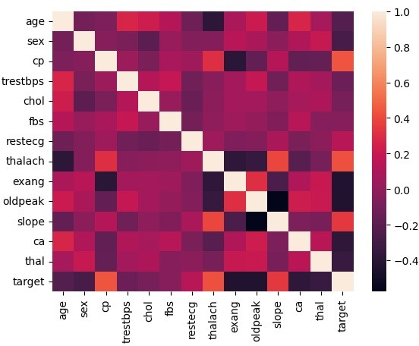








df.tail()
heart=df.drop(columns=['fbs','restecg','thalach','exang','slope','ca','thal']) heart
 | age | sex | cp | trestbps | chol | oldpeak | target
0 | 52 | 1 | 0 | 125 | 212 | 1.0 | 0
1 | 53 | 1 | 0 | 140 | 203 | 3.1 | 0
2 | 70 | 1 | 0 | 145 | 174 | 2.6 | 0
3 | 61 | 1 | 0 | 148 | 203 | 0.0 | 0
4 | 62 | 0 | 0 | 138 | 294 | 1.9 | 0
... | ... | ... | ... | ... | ... | ... | ...
1020 | 59 | 1 | 1 | 140 | 221 | 0.0 | 1
1021 | 60 | 1 | 0 | 125 | 258 | 2.8 | 0
1022 | 47 | 1 | 0 | 110 | 275 | 1.0 | 0
1023 | 50 | 0 | 0 | 110 | 254 | 0.0 | 1
1024 | 54 | 1 | 0 | 120 | 188 | 1.4 | 0
1025 rows × 7 columns
heart.head()
age | sex | cp | trestbps | chol | oldpeak | target
0 52 | 1 | 0 | 125 | 212 | 1.0 | 0
1 53 | 1 | 0 | 140 | 203 | 3.1 | 0
2 70 | 1 | 0 | 145 | 174 | 2.6 | 0
3 61 | 1 | 0 | 148 | 203 | 0.0 | 0
4 62 | 0 | 0 | 138 | 294 | 1.9 | 0
heart.tail()
 | age | sex | cp | trestbps | chol | oldpeak | target
1020 | 59 | 1 | 1 | 140 | 221 | 0.0 | 1
1021 | 60 | 1 | 0 | 125 | 258 | 2.8 | 0
1022 | 47 | 1 | 0 | 110 | 275 | 1.0 | 0
1023 | 50 | 0 | 0 | 110 | 254 | 0.0 | 1
1024 | 54 | 1 | 0 | 120 | 188 | 1.4 | 0

Slide 3



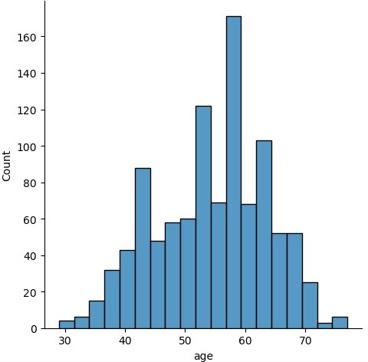

heart.describe()
 | age | sex | cp | trestbps | chol | oldpeak | target
count | 1025.000000 | 1025.000000 | 1025.000000 | 1025.000000 | 1025.00000 | 1025.000000 | 1025.000000
mean | 54.434146 | 0.695610 | 0.942439 | 131.611707 | 246.00000 | 1.071512 | 0.513171
std | 9.072290 | 0.460373 | 1.029641 | 17.516718 | 51.59251 | 1.175053 | 0.500070
min | 29.000000 | 0.000000 | 0.000000 | 94.000000 | 126.00000 | 0.000000 | 0.000000
25% | 48.000000 | 0.000000 | 0.000000 | 120.000000 | 211.00000 | 0.000000 | 0.000000
50% | 56.000000 | 1.000000 | 1.000000 | 130.000000 | 240.00000 | 0.800000 | 1.000000
75% | 61.000000 | 1.000000 | 2.000000 | 140.000000 | 275.00000 | 1.800000 | 1.000000
max | 77.000000 | 1.000000 | 3.000000 | 200.000000 | 564.00000 | 6.200000 | 1.000000
sns.displot(x['age'])
<seaborn.axisgrid.FacetGrid at 0x26222e90d60>
heart['age'].value_counts()

Slide 4




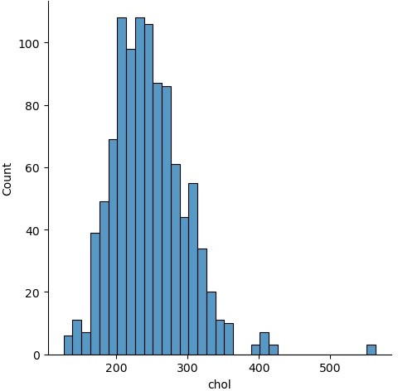

58 | 68
57 | 57
54 | 53
59 | 46
52 | 43
51 | 39
56 | 39
62 | 37
60 | 37
44 | 36
64 | 34
41 | 32
63 | 32
67 | 31
61 | 31
55 | 30
65 | 27
43 | 26
42 | 26
53 | 26
66 | 25
45 | 25
48 | 23
46 | 23
50 | 21
47 | 18
49 | 17
35 | 15
39 | 14
70 | 14
68 | 12
38 | 12
71 | 11
40 | 11
69 | 9
37 | 6
34 | 6
29 | 4
76 | 3
77 | 3
74 | 3
Name: age, dtype: int64
heart['age'].value_counts().keys()
Int64Index([58, 57, 54, 59, 52, 51, 56, 62, 60, 44, 64, 41, 63, 67, 61, 55, 65,
43, 42, 53, 66, 45, 48, 46, 50, 47, 49, 35, 39, 70, 68, 38, 71, 40,
69, 37, 34, 29, 76, 77, 74],
dtype='int64')
sns.displot(heart['chol']) plt.show()
sns.boxplot(heart['chol'])
<Axes: >

Slide 5
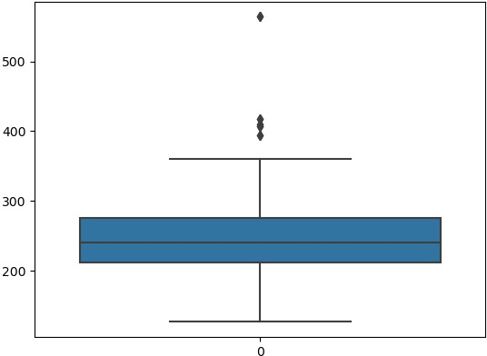



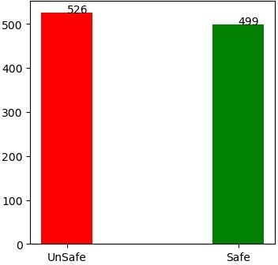





heart['target'].value_counts()
1
0
526
499
Name: target, dtype: int64
plt.figure(figsize = (4,4))
plt.bar(['UnSafe','Safe'],heart['target'].value_counts(),color = ['red','green'],width = 0.3)
for i,values in enumerate(heart['target'].value_counts()): plt.text(i,values,str(values))
df.columns
Index(['age', 'sex', 'cp', 'trestbps', 'chol', 'fbs', 'restecg', 'thalach',
'exang', 'oldpeak', 'slope', 'ca', 'thal', 'target'], dtype='object')
x = heart.iloc[:,:7] y = heart["target"]
x

Slide 6















 | age | sex | cp | trestbps | chol | oldpeak | target
0 | 52 | 1 | 0 | 125 | 212 | 1.0 | 0
1 | 53 | 1 | 0 | 140 | 203 | 3.1 | 0
2 | 70 | 1 | 0 | 145 | 174 | 2.6 | 0
3 | 61 | 1 | 0 | 148 | 203 | 0.0 | 0
4 | 62 | 0 | 0 | 138 | 294 | 1.9 | 0
... | ... | ... | ... | ... | ... | ... | ...
1020 | 59 | 1 | 1 | 140 | 221 | 0.0 | 1
1021 | 60 | 1 | 0 | 125 | 258 | 2.8 | 0
1022 | 47 | 1 | 0 | 110 | 275 | 1.0 | 0
1023 | 50 | 0 | 0 | 110 | 254 | 0.0 | 1
1024 | 54 | 1 | 0 | 120 | 188 | 1.4 | 0
1025 rows × 7 columns
y
0 | 0
1 | 0
2 | 0
3 | 0
4 | 0
 | ..
1020 | 1
1021 | 0
1022 | 0
1023 | 1
1024 | 0
Name: target, Length: 1025, dtype: int64
from sklearn.model_selection import train_test_split
x_train,x_test,y_train,y_test = train_test_split(x,y,test_size=0.3)
from sklearn.naive_bayes import GaussianNB gnb = GaussianNB()
confusin
▾ GaussianNB
GaussianNB()
y_pred=gnb.predict(x_test)
from sklearn.metrics import confusion_matrix,accuracy_score confusion_matrix(y_test,y_pred)
array([[152, 0],
[ 0, 156]], dtype=int64)
accuracy_score(y_test,y_pred) 1.0
Loading [MathJax]/jax/output/CommonHTML/fonts/TeX/fontdata.js

